Slide 1
ESC101: Fundamentals of Computing
Taking Inputs (scanf)
Nisheeth

Slide 2
Announcements
Graded labs starting today
Prutor accounts: Hopefully everyone now has a working Prutor account (accessible via your CC email id and CC password)
If not, please arrive at the lab early (by 1:45pm) and we will create your account on the spot

Slide 3
Recap
Every C program’s entry point (program’s execution starts here) is the main function
with return type integer
Tells C compiler to include the standard input/output library stdio.h (collection of functions such as printf, scanf, etc)
#include<stdio.h>
int main(){
printf(“Welcome to ESC101”);
return 0;
}
main function must open with left curly brace {
printf function prints a user specified output
main function must close with right curly brace }
Every statement in a C program must end with semi-colon ;
The main function must return
an integer (return 0 means successful execution of program)
printf(“Welcome to ESC101”) and return 0 are ‘statements’ in the above
code. Each C statement must end with a semi-colon ;
3

Slide 4
Recap
1
2
# include <stdio.h>
int main () {
int a = 1;
int b = 2;
int c;
c = a + b;
printf(“Result is %d”, c);
return 0;
}
a
b
Each variable’s declaration creates a “box” big enough to store it at a location in computer’s
main memory (RAM)
3
c
Assigning a value to the variable writes that value in the box
= and + are “operators”
= is assignment operator
+ is addition operator
a+b is an “expression”
The program prints the message “Result is 3”

Slide 5

What’s Wrong Here?
# include <stdio.h>
int main () {
int a = 1;
int b = 2;
c = a + b;
printf(“Result is %d”, c);
return 0;
}
Can’t assign a value to c since it has not been declared yet
Will NOT Compile

Slide 6
What’s Wrong Here?
# include <stdio.h>
int main () {
int a;
int b;
int c;
c = a + b;
printf(“Result is %d”, c);
return 0;
}
Can’t use variables a and b in this assignment operation since a and b have not been assigned a value (initialized) in this program
Will Compile but will print garbage

Slide 7
What’s Wrong Here?
# include <stdio.h>
int main () {
int a = 1;
int b = 2;
int c;
printf(“Result is %d”, c);
return 0;
}
Will print some garbage value since c has not been assigned a value (initialized) yet
Will Compile but will print garbage

Slide 8
What About This?
# include <stdio.h>
int main () {
int a;
int b;
int c;
c = a + b;
a = 2;
b = 1;
printf(“Result is %d”, c);
return 0;
}
Can’t use variables a and b in this assignment operation since a and b have not been assigned a value (initialized) in this program yet. Assigning a and b values later does NOT solve this problem
Will Compile but will print garbage

Slide 9
Lesson Learned
Declare and initialize (or assign values to) your variables properly before their use

Slide 10
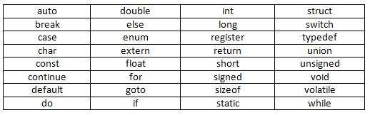
Recap: Alphabet and Keywords of C
C programs can be written using the following alphabet
A B .... Z
a b .... z
0 1 .... 9
Space . , : ; ‘ $ “
# % & ! _ { } [ ] ( ) |
+ - * / =
Keywords in C

Slide 11


Naming Convention for Variables and Functions
We have seen variables and their usage in programs
We have seen the main and printf function (and will see various other standard functions and user-defined function later)
Need to follow some rules for naming of variables and functions
Names can only contain A-Z, a-z, 0-9, and underscore _
Can’t begin a variable’s or function’s name with a number
A_3, abcDS2, this_variable are some valid names
321, 5_r, dfd@dhr, this variable, no-entry are some not valid names
Start with number
Contains special symbol @
Contains space character
Contains hyphen (“dash”) character -

Slide 12

Variables and Function Names: Some Suggestions
Should prefer short, meaningful names. Don’t use C keywords.
Multi-word name allows, e.g., firstNumber, first_number
Advice: Use capital letters for constants (e.g., NUMBER_DAYS_JAN)
Advice: Use small letters for variables (e.g., radius, volume)
Yes, but not advisable. May make mistakes, confuse others
#include <stdio.h>
int main(){
int temp, TEMP, Temp, TeMp;
return 0;
}
So this program is fine?
For me, the names temp, Temp, TEMP, TeMp are all different variable names

Slide 13
Recap: printf and its use
Note: In some cases,
there will be no such list.
Example: printf(“Hello”);
printf(format string, list of things to print);
printf(“Hello %d %d”, a,b);
Printing some characters, such as “, new-line, %, \
requires special care (need to use escape sequences)

Slide 14
Reading Inputs: The scanf function
Programs that don’t take inputs from user can be boring
We saw programs to add two numbers but both had to be written into code
Also called “hardcoding” the inputs
A bit like a calculator which can only add 5 and 4
To add 6 and 9, write a new calculator
Can’t we ask Mr C to request us for the numbers when he is executing our requests i.e. at runtime?
YES, by taking input from the user using scanf function

Slide 15
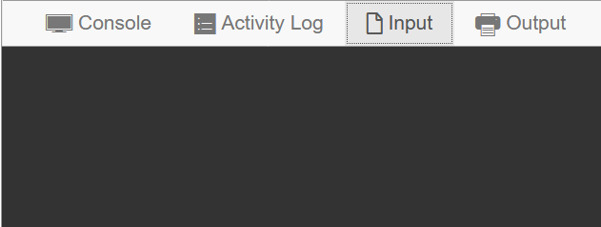

Example: Adding Two User-provided Numbers
#include <stdio.h>
int main(){
int a, b;
scanf(“%d”, &a);
scanf(“%d”, &b);
printf(“%d”, a + b);
return 0;
}
3
8
a
b
Thanks. Let me get back to work
11
Please give me input
11

Slide 16
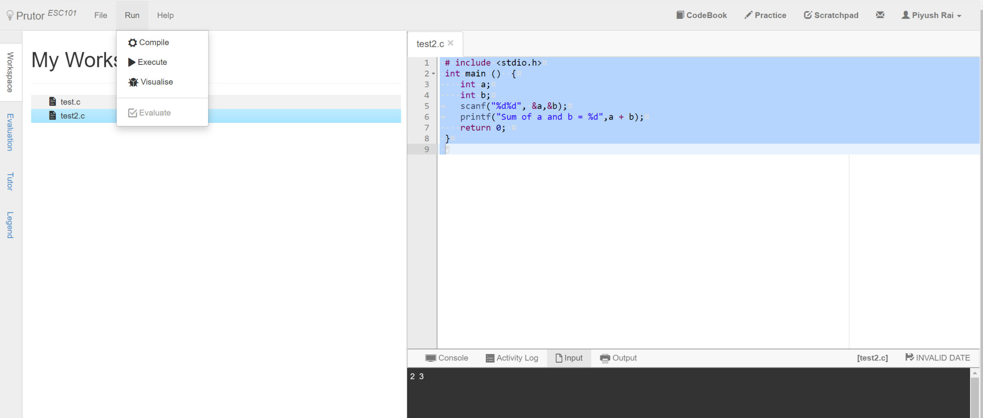
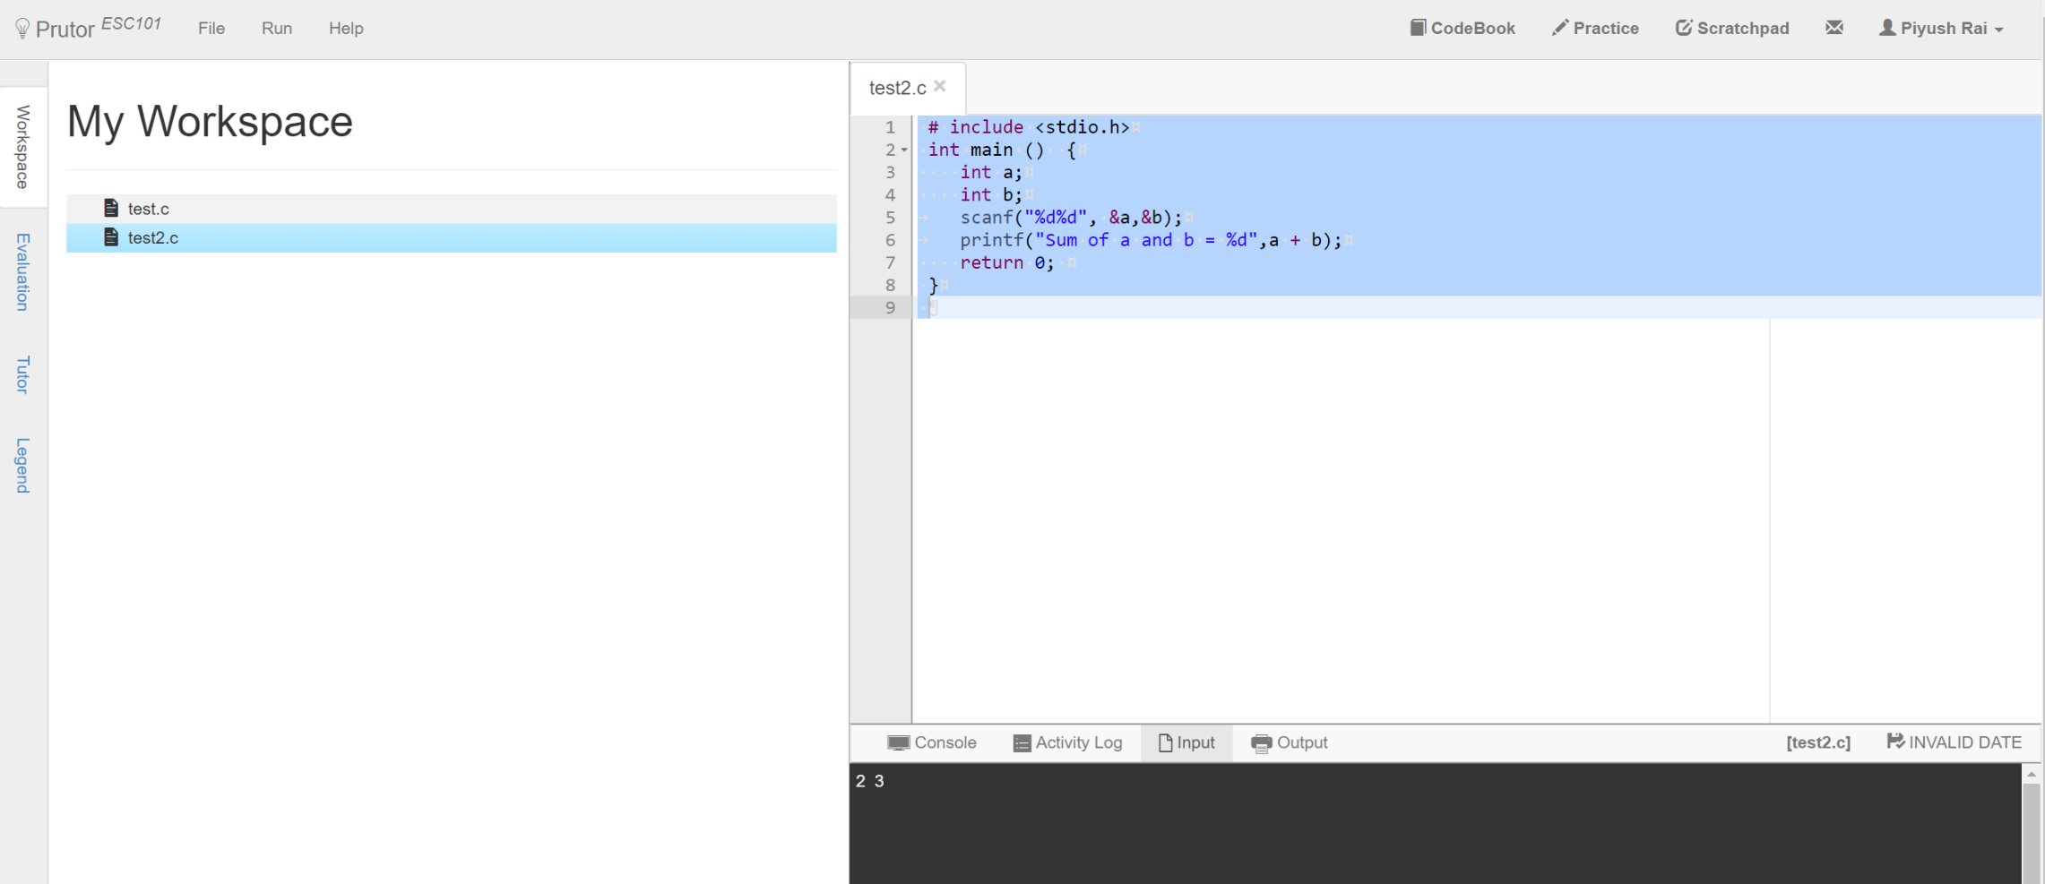
scanf: Some Words of Caution
In Prutor, input has to be specified before “Execute”

Slide 17



scanf: Some Words of Caution
Both work! Experiment!
In Prutor, input has to be specified before “Execute”
Please be very careful about this common mistake
Will explain what this & symbol means, in a few weeks
Yes, in printf they are different but in scanf, both look like whitespaces to me
Space, Tab, Newline are called whitespace characters since they are invisible ☺
scanf(“%d”,a);
scanf(“%d”,&a);
TAB
SPACE
NEWLINE
Why? Space is not same as newline 😐
Huh! What is a whitespace?

Slide 18



Taking Multiple Inputs using a Single scanf
#include <stdio.h>
int main(){
int a, b;
scanf(“%d%d”, &a, &b);
printf(“%d”, a + b);
return 0;
}
3
8
Help!!!
a
b
You entered only one integer
All look the same to me
11
11
Okay okay
Input please
Thanks

Slide 19
How does scanf work ?
How we must speak to mr. compiler
How we usually speak to a human
scanf(“%d%d”, &a, &b);
Please read one integer. Ignore all whitespace (spaces,tabs,newlines) after that till I write another integer. Read that second integer too.
Store value of the first integer in a and value of second integer in b.
Format string
Format string tells me how you will write things, and then I am told where to store what I have read
Remember Mr. C likes to be told beforehand what all we are going to ask him to do!
Scanf follows this exact same rule while telling Mr. C how to read

Slide 20
How does scanf work ?
Be a bit careful since Mr C is a bit careless in this matter
He treats all whitespace characters the same when integers are being input
scanf will never print anything
Use printf to print and scanf to read
Try out what happens with the following
My advice to you is to take input one at a time in the beginning ☺ Try out acrobatics in free time
Hmm … you are going to write the English word Hello followed by space followed by an integer. I will store the value of that integer in a
scanf(“Hello %d”,&a);
scanf(“%d %d”,&a,&b);
scanf(“%dHello%d”,&a,&b);
scanf(“%d,%d”,&a,&b);
scanf(“\“%d%d\“”,&a,&b);
scanf(“%d\n%d”,&a,&b);
scanf(“%d\t%d”,&a,&b);

Slide 21

Commenting Your Code
Okay. I will add your two numbers
Last week we learned about “indentation”
Let us learn about “comments” today
Absolutely essential in industry, even self projects
How we write commented code
What Mr C sees
int main(){
int a;
int b;
a = 5, b = 4;
int c = a + b;
printf(“c = %d”,c);
return 0;
}
int main(){
int a; // My first int
int b; // The other int
// Assign them values
a = 5, b = 4;
int c = a + b;
printf(“c = %d”,c);
return 0;
}
int main(){
int a;
int b;
a = 5, b = 4;
int c = a + b;
printf(“c = %d”,c);
return 0;
}
Only humans see comments

Slide 22


Several Ways of Writing Comments
Since it is an art form, artists differ on what is more pretty
int main(){
int a; // My first int
int b; // The other int
// Assign them values
a = 5, b = 4;
a + b;
return 0;
}
int main(){
int a; /* My first int */
int b; /* The other int */
/* Assign them values */
a = 5, b = 4;
a + b;
return 0;
}
int main(){
int a; // My first int
int b; // The other int
/* Assign them values */
a = 5, b = 4;
a + b;
return 0;
}
Yes. In fact /* */ is used to comment several lines at once – shortcut!
So I can mix and match?
Just be a bit careful. Some compilers don’t understand // comments

Slide 23
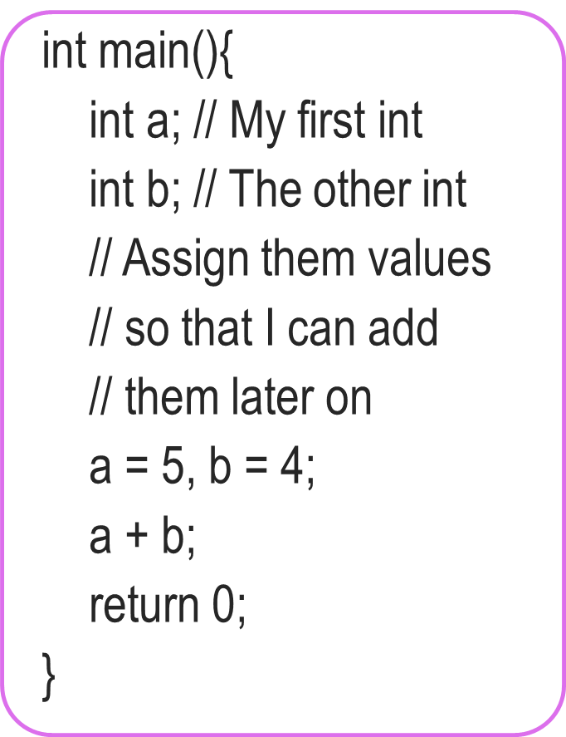
More on Comments
Use comments to describe why you defined each variable and what each step of your code is doing
You will thank yourself for doing this when you are looking at your own code before the endsem exams ☺ ☺
Your team members in your company/research group will also thank you
Multiline comments very handy. No need to write // on every line ☺
int main(){
int a; // My first int
int b; // The other int
/* Assign them values
so that I can add
them later on */
a = 5, b = 4;
a + b;
return 0;
}

Slide 24


A Useful Tip While Problem-Solving
Comments can be also used to identify where is error
Mr C will tell you (compile) where he thinks the error is
Commenting out lines can also help identify the error
Error!
Okay!
Okay!
int main(){
int a, b;
c = a + b;
a = 5;
b = 4;
return 0;
}
int main(){
int a, b;
// c = a + b;
a = 5;
b = 4;
return 0;
}
int main(){
int a, b, c;
c = a + b;
a = 5;
b = 4;
return 0;
}
Aha! I forgot to declare c

Slide 25
Take Care with Formulae: Using Brackets Help
Bracket, Of, Division, Multiplication, Addition, Subtraction
Operation | C Code | a | b | c
Addition | c = a + b; | 5 | 4 | 9
Subtraction | c = a – b; | 4 | 5 | -1
Multiplication | c = a * b; | -2 | -4 | 8
Division | c = a / b; | 7 | 2 | 3
Remainder | c = a % b; | 7 | 2 | 1
Bracketing | c = (a+b)/2; | 5 | 1 | 3
 | c = a + b/2; | 5 | 1 | 5
Recall your BODMAS order rules from high school
Mr. C follows similar rules – will see in detail soon
Good practice to bracket your formulae
Minimize confusion as well as chances of error
Play with brackets in lab to practice

Slide 26
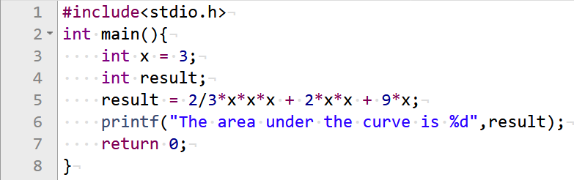

A Useful Tip While Solving Problems
Print your solutions to each one of these pieces to see where going wrong
Try breaking up the problem into smaller pieces
I have no idea what is going wrong here!

Slide 27
A Useful Tip While Solving Problems
Equals 0

Slide 28
A Useful Tip While Solving Problems
Replace this part by (2*x*x*x)/3

